Slide 1


Machine Learning Models Development:
Clusters and Predictors
Collins Madisife
Prospective Data Scientist

Slide 2


Clustering: Partitioning Samples into Groups
Objective: Identify samples with shared features and cluster them into groups
Methodology: Scikit-learn’s KMeans Algorithm was used to achieve this purpose
Procedure: Steps taken include>
Data Preparation and Standardization
Trained and fitted the model using KMeans
Exploration and Description of Clusters
One-hot encoding of features for machine learning compatibility
Since they do not have the same range and unit of measurement.
Handled illegitimate impact of variables on model algorithm
Initial n_cluster of 3 was used i.e. three groups were labeled
The Elbow method was used to verify optimal number of clusters for the supplied dataset
The clusters were explored and important metrices describing each clusters were reported

Slide 3
Statistical Description of the Data
Metric | age | sex | plan | company | provider | pxt_enc_date | claim_sub_date | paymt_date | serv_type | diagnosis | total_price
count | 5000 | 5000 | 5000 | 5000 | 5000 | 5000 | 5000 | 5000 | 5000 | 5000 | 5000
unique | NaN | 2 | 58 | 3 | 302 | 407 | 288 | 133 | 2 | 3622 | NaN
top | NaN | M | RED Family | CORPORATE | IGWE HOSPITAL NIG. LTD | 08-10-98 0:00 | 06-12-98 0:00 | 11-12-98 0:00 | Outpatient | MALARIA | NaN
freq | NaN | 2773 | 1469 | 2693 | 175 | 42 | 73 | 166 | 4662 | 141 | NaN
first | NaN | NaN | NaN | NaN | NaN | 18-02-97 0:00 | 28-11-97 0:00 | 02-01-98 0:00 | NaN | NaN | NaN
last | NaN | NaN | NaN | NaN | NaN | 27-02-99 0:00 | 27-02-99 0:00 | 27-02-99 0:00 | NaN | NaN | NaN
mean | 30.4604 | NaN | NaN | NaN | NaN | NaN | NaN | NaN | NaN | NaN | 9588.5752
std | 15.1434 | NaN | NaN | NaN | NaN | NaN | NaN | NaN | NaN | NaN | 17933.369
min | 0 | NaN | NaN | NaN | NaN | NaN | NaN | NaN | NaN | NaN | 90
25% | 26 | NaN | NaN | NaN | NaN | NaN | NaN | NaN | NaN | NaN | 3215
50% | 32 | NaN | NaN | NaN | NaN | NaN | NaN | NaN | NaN | NaN | 5279.2
75% | 38 | NaN | NaN | NaN | NaN | NaN | NaN | NaN | NaN | NaN | 9630
max | 134 | NaN | NaN | NaN | NaN | NaN | NaN | NaN | NaN | NaN | 400000

Slide 4
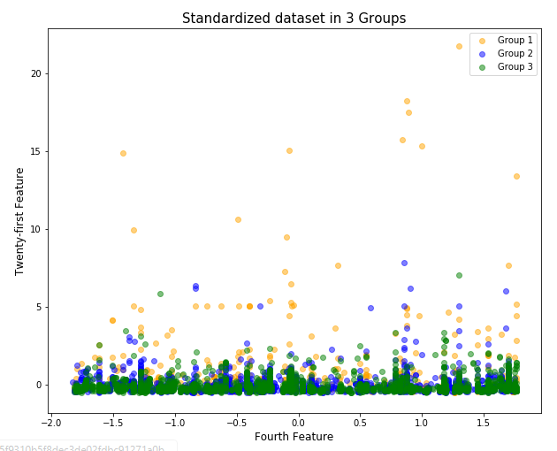
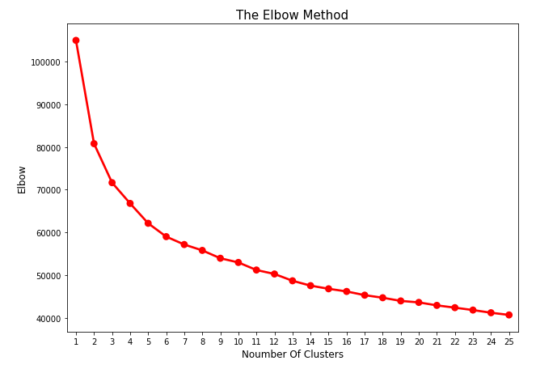
Training and Fitting the model
Display showing a plot of two clusters feature, with clear distinction of clusters by color
The Elbow method confirms that 3 clusters are optimal for grouping the dataset

Slide 5
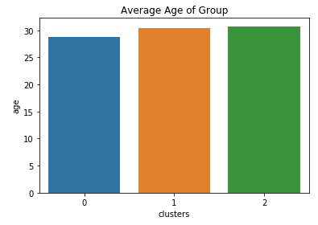
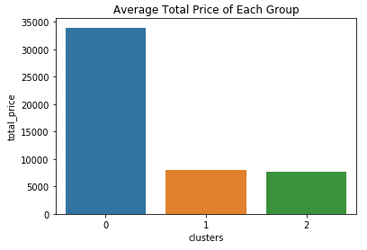
Description of Clusters
Mean age of each group is between 28 to 30 years
Group1 have claimed an average of N35,000 in health insurance compared to Groups 2 and 3 which are both less than N10,000 each
Reliance paid a total of N11.5million, N19million and N17.4million to groups 1,2 and 3 respectively
In all three groups, the ‘RED Family’ health insurance plan seem to be the most common plan used by members
Group1 members are mostly Inpatient cases compared to Group 2 and 3
Majority of users from all three groups are Corporate users i.e. purchased by employers on their behalf
Majority of claims from Group 1 came from the provider, GLORY SPA.
Majority of claims from Group 2 came from the provider, LOYOLA SPECIALIST HOSPITAL
Majority of claims from Group 3 came from the provider, IGWE HOSPITAL NIG. LTD

Slide 6
Regression Models: Total Price Predictors
Objective: Develop ML models that rightly predicts the Total Price
Methodology: Scikit-learn’s Regression algorithms
Procedure: Steps taken include>
Split data into training and testing samples. Deployed regression algorithm
Data Preparation and Standardization
Model Evaluation and Prediction
One-hot encoding of features for machine learning compatibility
Since they do not have the same range and unit of measurement.
Handled illegitimate impact of variables on model algorithm
Train_test_split module for splitting dataset
LinearRegression and Support Vector Machine regression algorithms were deployed (SVR and LinearSVR)
Models were evaluated using Root Mean Squared Error
Visual model performance using Distplot
Prediction of Total Price using models

Slide 7
Training and model evaluation
The data set was split into 75% and 25% for training and testing respectively
Three regression models were built in order to get the best performer of all three
Linear Regression model performed poorly of the three in terms of root mean squared error
However, it performed the best in terms of predictability and distribution of values
Model | Root Mean Squared Error
LinearRegression | 65927.34
SVR | 36259.66
LinearSVR | 29331.86

Slide 8
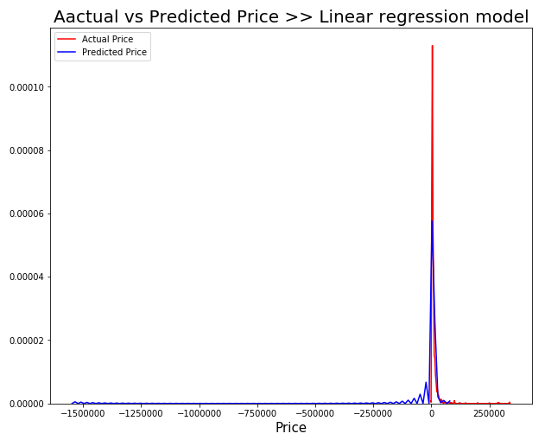
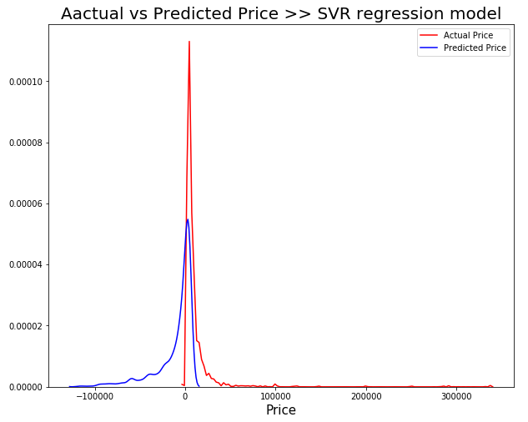
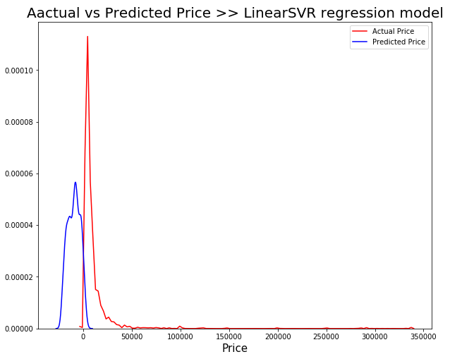
Model evaluation: Visualizer
The distribution plot from seaborn was used to visualize the performance of the models relative to actual price values

Slide 9
Conclusion
The exercise was completed and objectives met
Cluster groups in the data set were identified and proper description was given for each group. Also, relationships and similarities were exploited
Total price predictive models were built using regression algorithms from the Scikit-learn library of python
The models were evaluated and performance measured. However, given the time frame for this project, it is safe to say that these models could have been fine tuned to be better than they currently are.
In general, it was an interesting project and one that I enjoyed

